Slide 1

Document ID
Version: 1.0
Standard Operating Procedure for Delegation of Authority
Date of creation: 2024 April 04
Farzana
PARTICULARS
Scope
Responsibilities
Procedure
Flowchart

Slide 2
Purpose
The purpose of this SOP is to establish a transparent and efficient process for delegating financial authority, thereby maintaining financial control, ensuring compliance, and optimizing decision-making processes.
Scope
This SOP governs the delegation of financial authority within the organization, ensuring compliance with internal policies and regulatory standards.

Slide 3
Responsibilities
Senior Management
Responsible for defining objectives, approving the SOP, and ensuring adherence to the established procedures.
Finance Department
Responsible for facilitating the implementation of the SOP, conducting training, and monitoring compliance..
Managers and Employees
Responsible for understanding and adhering to the delegated financial authority levels and following the prescribed procedures.
4

Slide 4
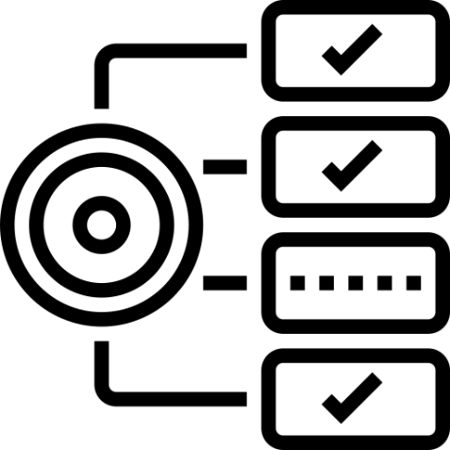


Requirements
Clear understanding of the organization's financial structure and hierarchy.
Familiarity with relevant financial regulations and internal policies.
Proficiency in documentation and communication skills.

Slide 5
Procedure for Delegation of Authority
Defining objectives and Scopes
Clearly outline the objectives of the SOP for the delegation of financial authority.
Specify the scope, indicating the financial areas and levels of authority it covers.
2. Understanding existing process
Identify key stakeholders involved in financial decision-making, including finance department heads, managers, and employees
Conduct stakeholder interviews
Document the current state of financial delegation processes within the organization
Identify any challenges or gaps in the current delegation framework.
3. Document Process Steps
Specify different levels of financial authority within the organization.
Clearly outline the decision-making powers associated with each level, including spending limits and approval thresholds.
Define how financial delegations are communicated to all relevant parties.
Specify the documentation requirements for all financial delegation activities.
Clearly outline the roles and responsibilities of individuals involved in the financial delegation process.
Anticipate and document procedures for handling exceptions or deviations from the standard financial delegation process.
Ensure that the SOP complies with relevant financial regulations, internal policies, and industry standards.

Slide 6
4. Review and Approval Process
Identify Reviewers and Approvers and establishing review timelines
Distribute the SOP for Review and collect feedback
Compile and analyze feedback and do revision and clarification
Second Review (if necessary)
Authorization and implementation
5. Training and Development
Making people know the importance of DOA and how this would help them
Implement the SOP and monitor its effectiveness over time
6. Monitoring and Reporting
Implement a system for monitoring the performance of the delegation process based on the defined KPIs.
Generate regular reports to assess efficiency and identify areas for improvement.

Slide 7
General Instructions
Adhere strictly to the prescribed levels of financial authority outlined in this SOP.
Communicate any deviations or exceptions to the designated authorities promptly.
Maintain accurate documentation for all financial delegation activities.
Seek clarification from senior management or the finance department in case of ambiguity or uncertainty.
Regularly review and update the SOP to reflect any organizational changes or regulatory updates.
8

Slide 8
General Challenges
Resistance to change from employees accustomed to previous delegation practices.
Ensuring consistent interpretation and application of financial authority levels across departments.
Balancing delegation of authority with maintaining sufficient oversight and control.
Addressing conflicts of interest or potential ethical dilemmas in decision-making processes.
8

Slide 9
Process Implementation Checklist
Do’s | Don’ts
Do adhere strictly to the prescribed financial authority levels. | Don't exceed delegated financial authority without proper authorization.
Do communicate effectively with relevant stakeholders regarding financial decisions. | Don't overlook documentation requirements for financial transactions
Do seek clarification or guidance when uncertain about delegated authority. | Don't ignore potential conflicts of interest or ethical considerations in decision-making
Do maintain accurate and up-to-date documentation of financial transactions | Don't hesitate to escalate issues or concerns to senior management or the finance department when necessary.
8

Slide 10
Inputs

Slide 11
Link to Sample

Slide 12
Revision History
Appendix
Archives

Slide 13
THANKYOU

